Slide 1

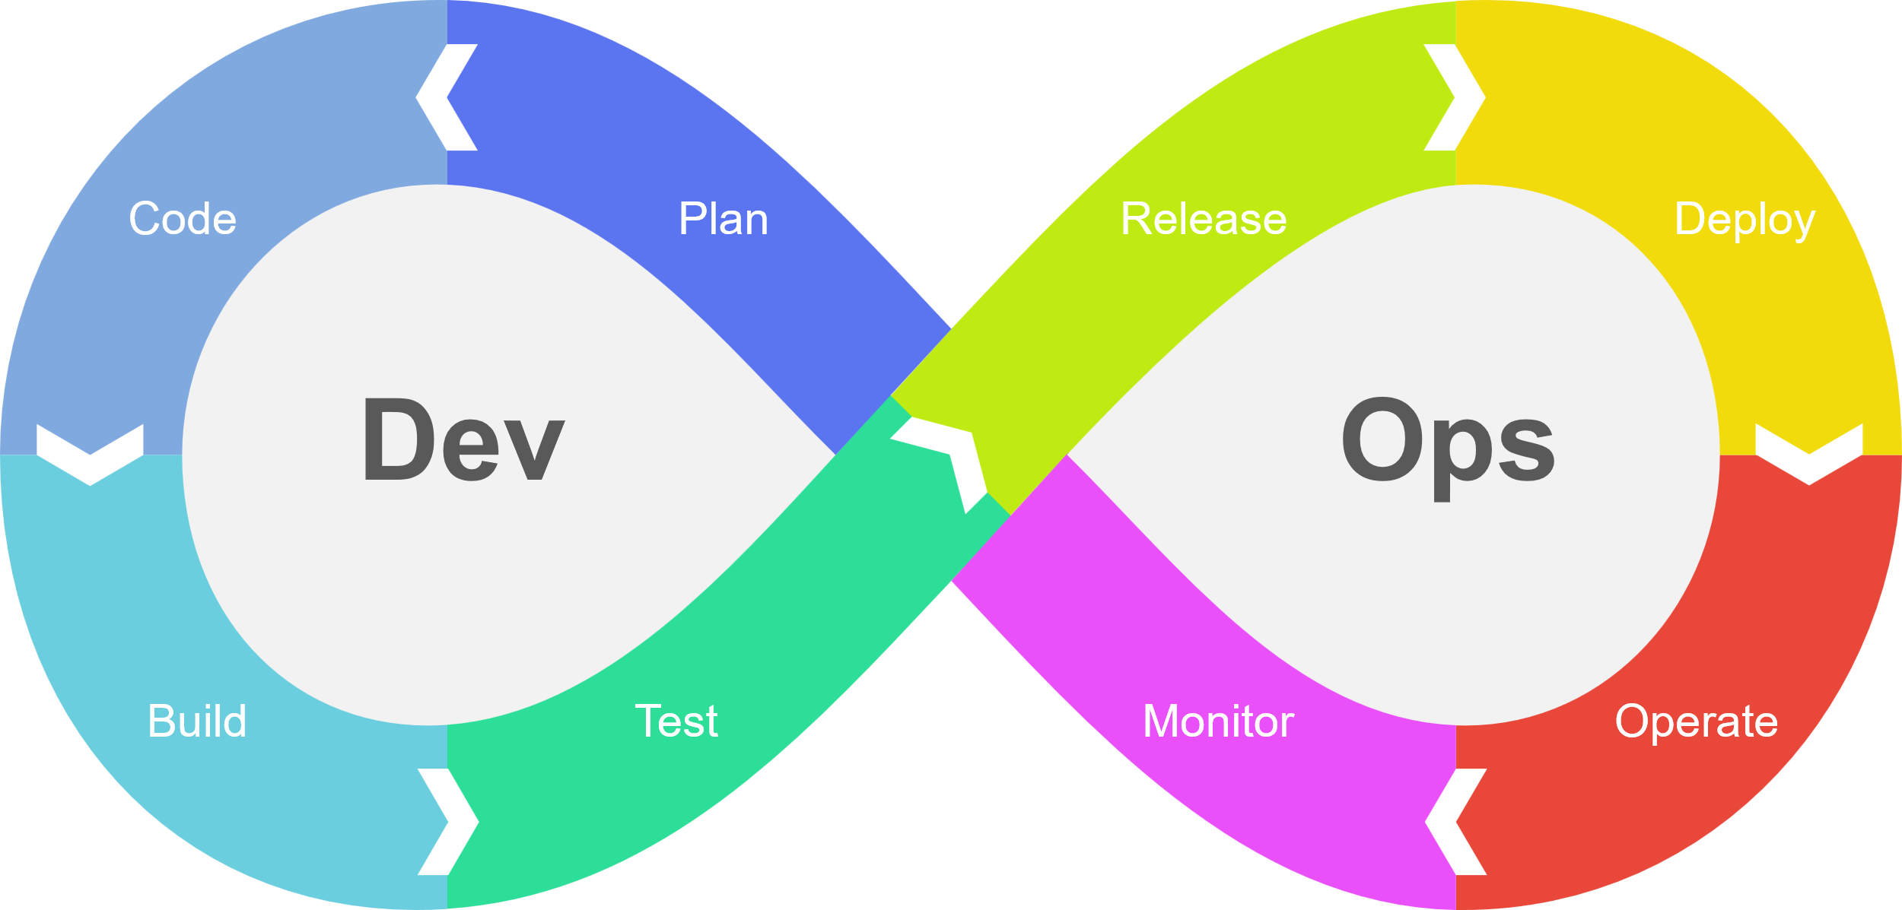
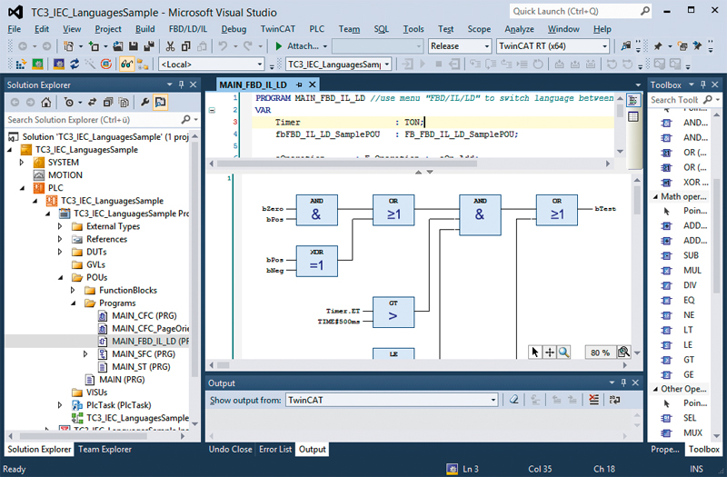
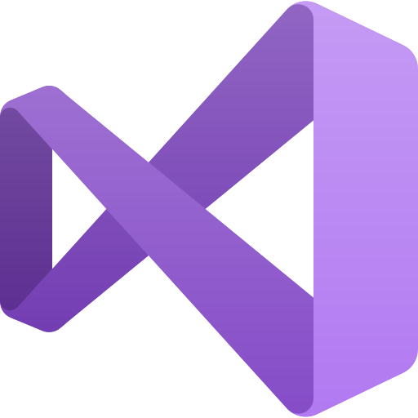

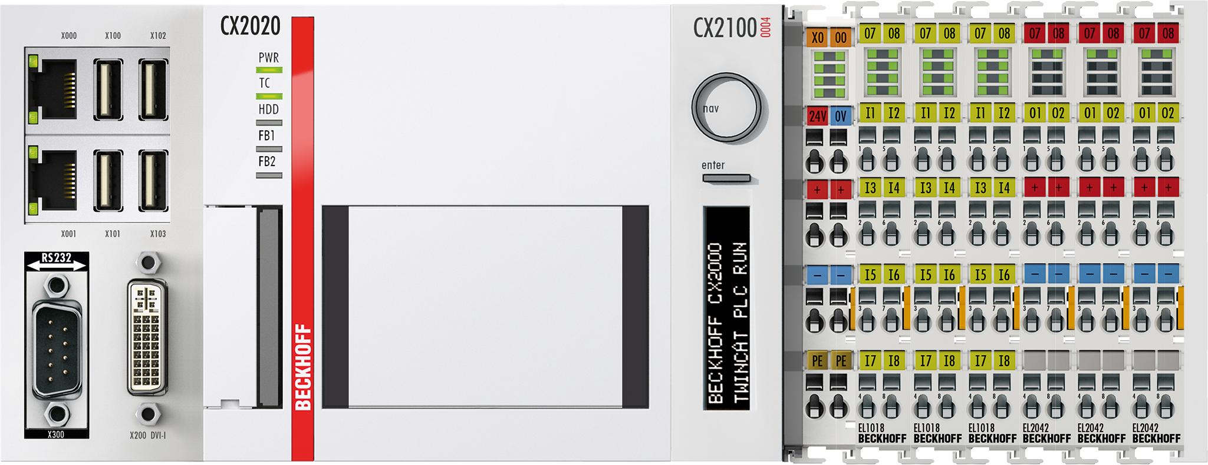

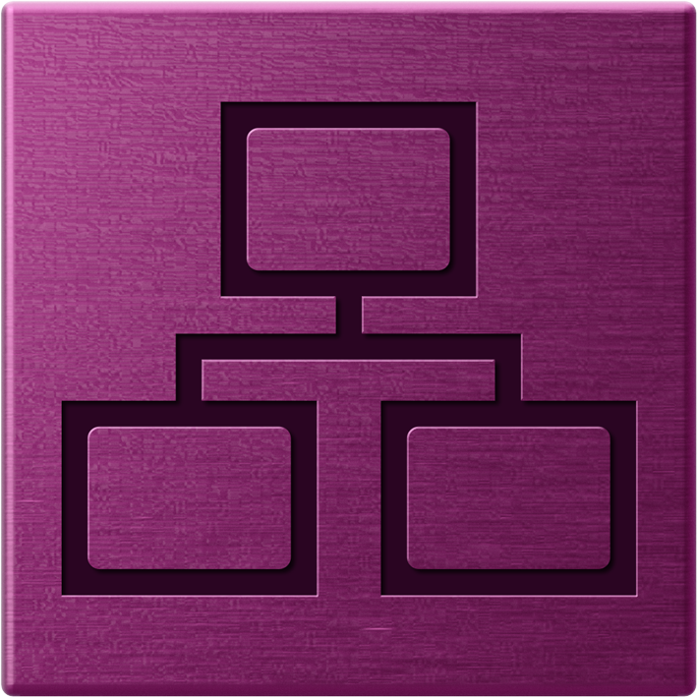

CI/CD & DevOps with TwinCAT

Slide 2




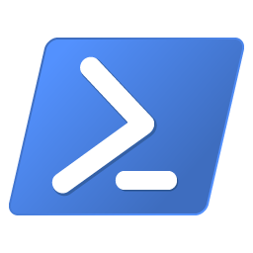






DevOps Workflow with TwinCAT
From TwinCAT source code to an updated TwinCAT Target System in an automatic and reproduceable way
Tools and Workflows for an agile DevOps life cycle with TwinCAT
Git based version control of TwinCAT projects
Automated build of TwinCAT applications
Enabled by Automation Interface
TwinCAT tools for test systems
Scalable release and deployment processes
Monitoring of production systems

Slide 3
TwinCAT Automation Interface Overview
Facilitates automation within the TwinCAT development environment
Automate configuration, code generation, building and deployment
Leverages Visual Studio automation API
Support for system, motion, PLC, HMI, measurement, etc. projects
Scan, configure and link I/O
CPU and task configuration
Download and activate remote targets
Program, build and run PLC projects
C#, C++ and PowerShell APIs
Basically, any operation you (as a user) can perform in the TwinCAT development environment can be automated with Automation Interface.
Notes:
Few logical exceptions to automating operations, e.g. Safety runtime activation requires manual password entry, etc.

Slide 4



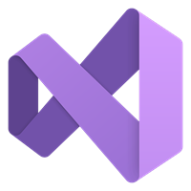
TwinCAT Automation Interface Sample
Simple PowerShell script to open and build a TwinCAT solution:
# instantiate DTE
$dte = new-object -com "VisualStudio.DTE"
$dte.SuppressUI = $true
# path
$slnPath = "$pwd\.."
# open solution file
$sln = $dte.Solution
$sln.Open("$slnPath\TwinCAT Project.sln")
# build entire solution
$sln.SolutionBuild.Build($true)
# output: “$slnPath\_Boot\TwinCAT RT (x64)”
# close VS
$dte.Quit()
Repo
_Boot
PLC
Scripts
build.ps1
.gitignore
TwinCAT Project.sln

Slide 5
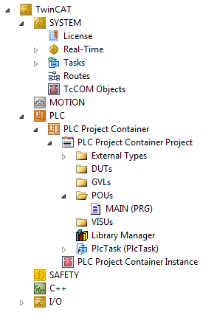
TwinCAT Automation Interface How does it work?
TwinCAT 3 stores configuration in a tree structure
Each tree item contains information about
configuration settings
sub-items and parent item
Automation Interface provides methods to
“Navigate through tree and execute operations on a tree item”
Examples:
“Navigate to TwinCAT\I/O and create a new EtherCAT Master”
“Navigate to TwinCAT\PLC and create a new PLC project”
“Navigate to TwinCAT\SYSTEM\Tasks\PlcTask and set cycle time to 10ms”
Parent
Tree item “POUs”
Name
Settings
Child[]

Slide 6
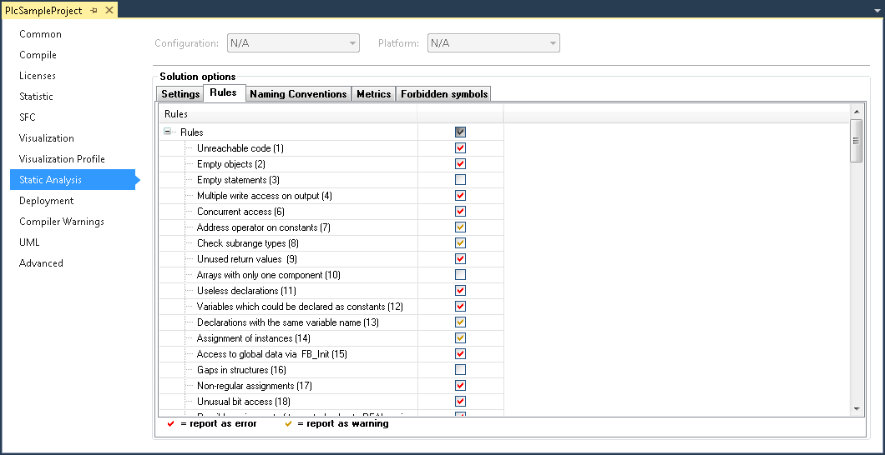
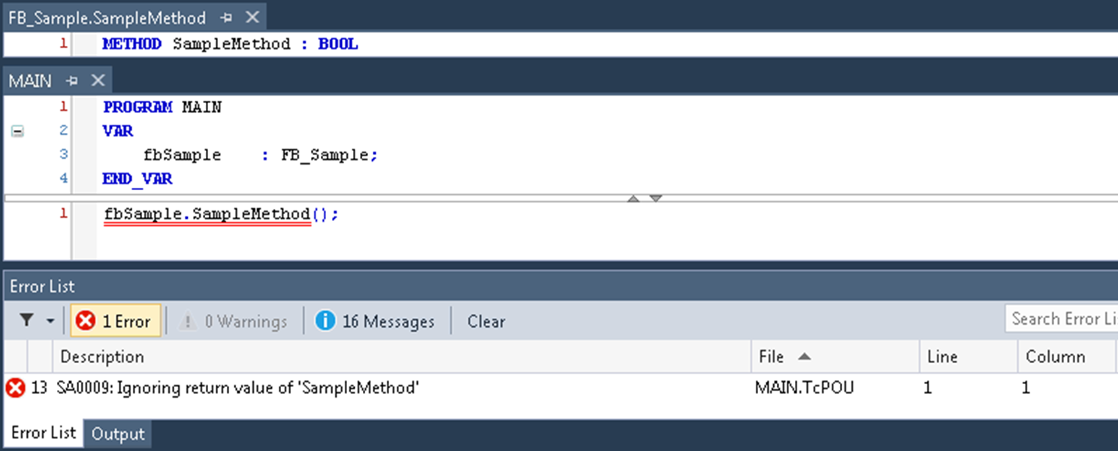
Build & Test Tooling TwinCAT PLC Static Analysis
Code quality and standardization tooling
Compiler “supplement”
Enforce coding rules, naming conventions, forbidden symbols
Advanced module metrics
Code size, stack size, global variable access, etc.
Notes:
Naming convention rules e.g.
“Function Block definitions must be prefixed with FB_”, e.g. FB_Axis
“Function Block instances must be prefixed with fb” e.g. fbConveyorAxis

Slide 7
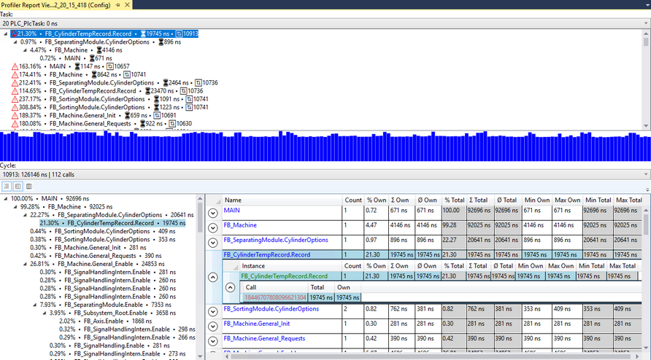
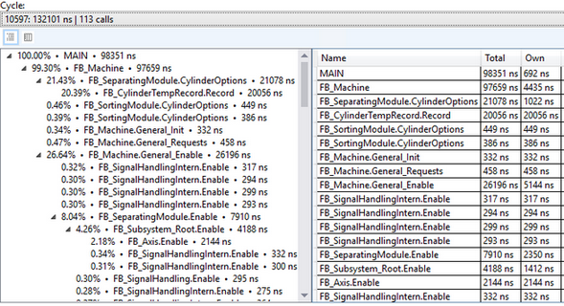
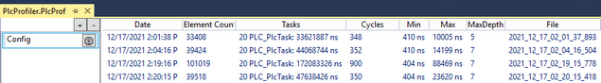
Build & Test Tooling TwinCAT PLC Profiler
Comprehensive PLC runtime analysis
Timing and CPU utilization by individual code module
Contextualized as % of total task execution
Call stack hierarchy

Slide 8
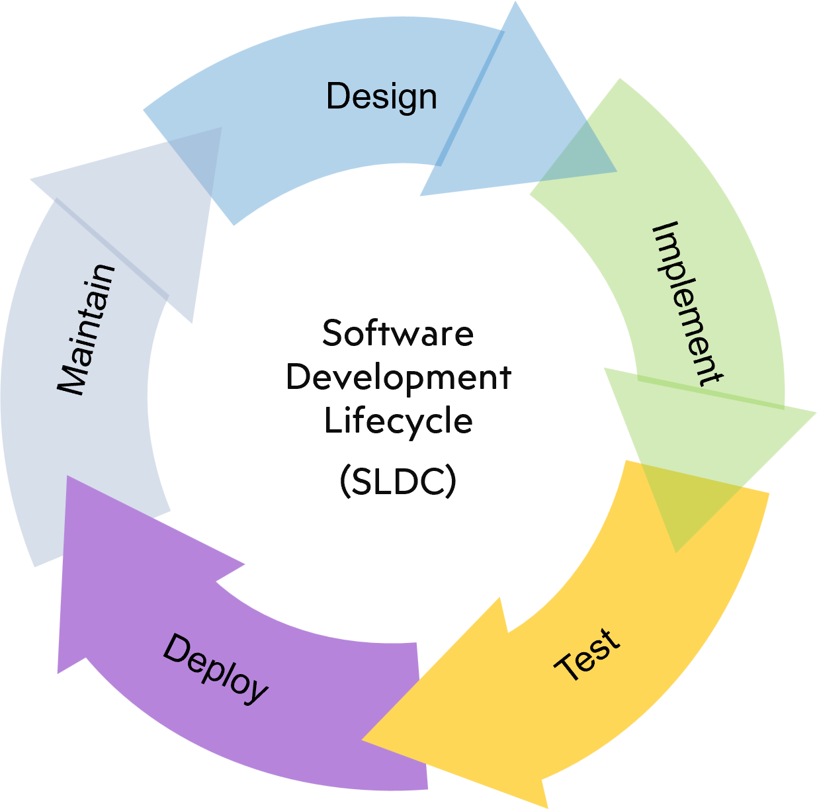

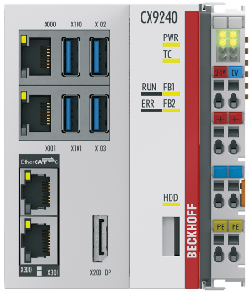
Build & Test Tooling ADS
The communication protocol for TwinCAT
Open, robust, secure
Platform, language and OS independent
Easy access to PLC variables
Names, values, complex and primitive typing
Polling or value changed events
Execute remote procedure calls
Official client implementations for:
.NET
C++
Java
Powershell
Third party implementations for many others:
Python, C, node/JS, Go, and more!
Any OS
Any language
Network routable
Notes:
Simple example might be, read the value of this simple.
More advanced example which illustrates the powerful integration with the type system in following slides.

Slide 9
Build & Test Tooling ADS
Example: Automated testing of PLC POU (function blocks)
>
list all PLC POUs that implement the ‘ITest’ interface
>
fbCylinder1_Test
fbSequence_Test
fbIoMsg_Test
fbCylinder2_Test
…
Build/Test Agent
Notes:
Advanced example
Combines multiple concepts: OOP, Testing, etc.

Slide 10


Build & Test Tooling Test and Deploy - ADS
Example: Automated testing of PLC POU (function blocks)
>
fbCylinder1_Test
fbSequence_Test
fbIoMsg_Test
fbCylinder2_Test
…
>
run the Execute() method on each instance and report back the results
Build/Test Agent

Slide 11

Build & Test Tooling Azure DevOps Demo

Slide 12
Workflow
System is programmed and configured in TwinCAT XAE.
Artifact is deployed to the remote target.
Changes are committed to the repository.
Automation Interface scripts can remotely activate the program and configuration changes during scheduled downtime.
A ‘push’ to the remote repository triggers the build process.
Automation Interface scripts on the agent build and test the updates. The build output is packaged as an artifact.
Beckhoff connectivity, measurement and analytics tooling can be used to monitor controller health, performance and process data.
Static Analysis can enforce organizational code quality rules during the build process.

